Slide 1
Extended GNSS
ASE 372N
Matthew Cullen Self
December 9, 2016

Slide 2
Feasibility of Using GPS in Space
Will my GPS receiver work on the moon?

Slide 3
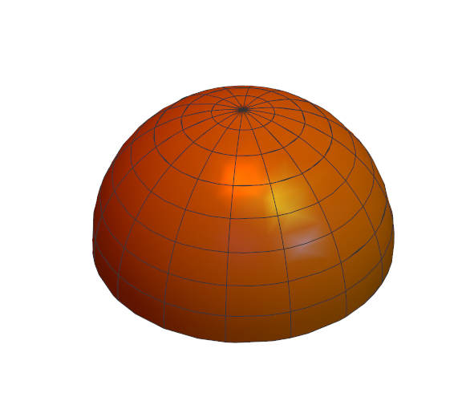
How GNSS SVs Broadcast
Antenna pointed at Earth
Emit a Hemisphere of Radio Waves
Most power in “Main Lobe”
“Side Lobes” still have some power
Notes:
Maybe add hemisphere graphic, or emitted power from SSV #19, cite GNSS satellite geometry and attitude models

Slide 4
Baseline
Classified Geosynchronous Satellite (42,164 km)
AMSAT-Oscar-40 (58,800 km)
GIOVE-A SGR-GEO (23,200 km)
MMS (76,000 km)
Notes:
Geosync – since 1990, not published how many SV tracked, entire signal is downlinked to process, included in nav model
Ao40 – launched 2000, not very powerful tracking, max of 2 sats tracked
GIOVE – launched 2005, Galileo test sat, onboard rx was able to produce nav sols with vdop 50-100m, hdop 10-15m (
MMS – launched 2015, has Navigator receiver - tracked at least 4 sats all the time
Cite: ssv, gps2000 [kronman], ao40, gps receiver dem 2007

Slide 5
Process
Can I test without going to the moon?

Slide 6
Quality of the Receiver
Antenna
Noise
Gain
Tracking Algorithm

Slide 7


Governing Equations
Notes:
Intro unbiased cn0

Slide 8
Data Sources
Gain patterns of GPS Block IIR & IIR(M) SVs (Lockheed Martin)
GNSS Attitude Models (Montenbruck)
Notes:
Given in terms of offbore sight theta, and clock angle phi
Cite GPS Block… Marquis
Cite montenbruck

Slide 9
Assumptions
All SVs are similar
SVs nominally emit 30 dBW of power
Receiver has uniform gain

Slide 10
Results
Where GPS Receivers Work

Slide 11
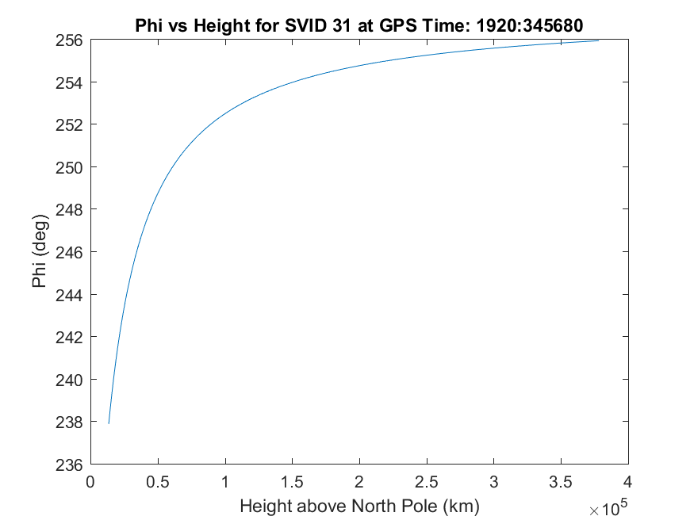
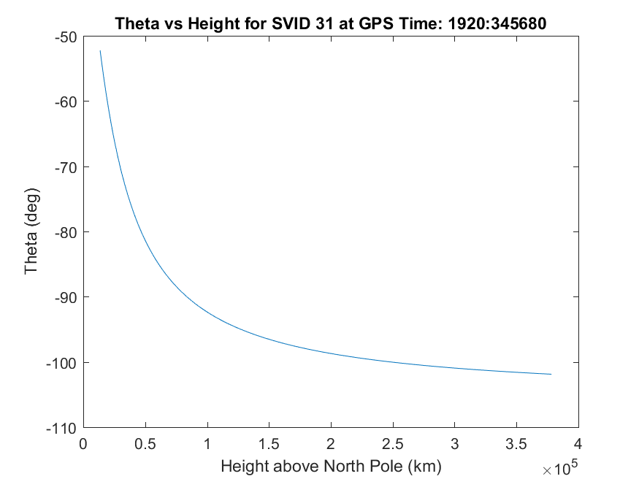
Single SV
Notes:
Actual sv location at given time, but modeled observer location above north pole

Slide 12
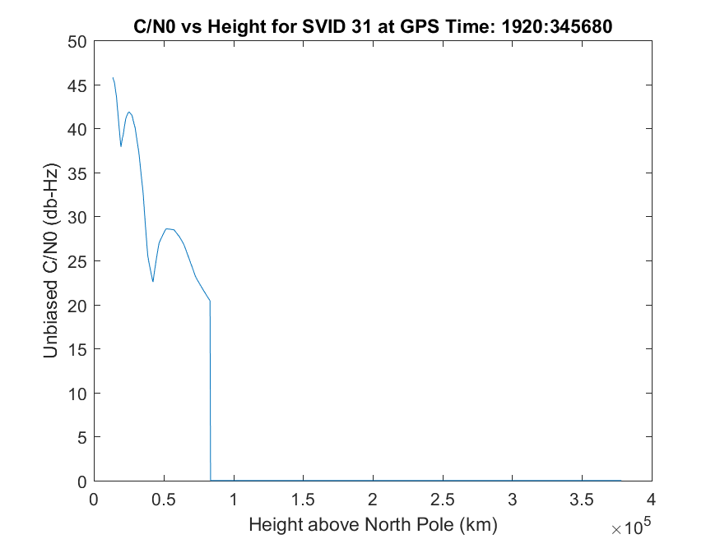
Single SV
Notes:
Note drop off corresponding to when theta>90 on previous slide

Slide 13
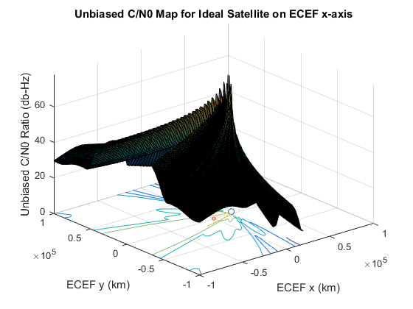
Single SV
Notes:
Unbiased c/n0 – not accounting for rxgain or rxnoise or thermal noise

Slide 14
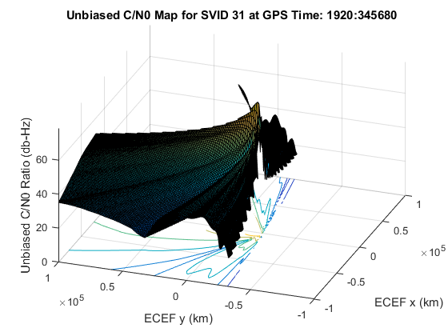
Single SV

Slide 15
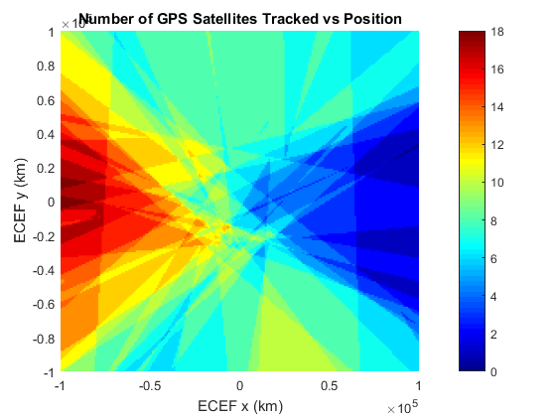
Many SVs

Slide 16
DOP

Slide 17
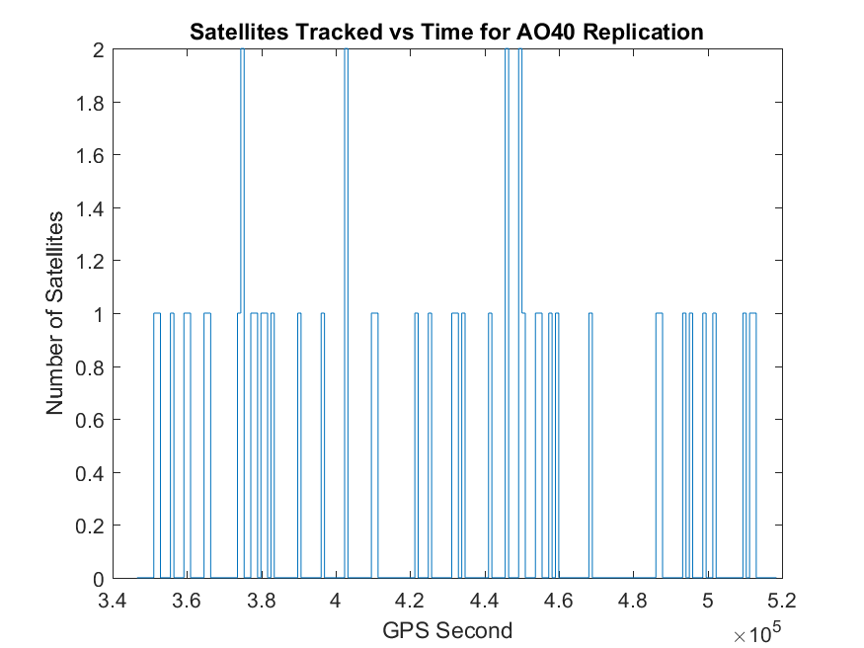
AO40 Replication
Notes:
0.24 sats on average – every 15 mins, threshold = 40 dbHz

Slide 18
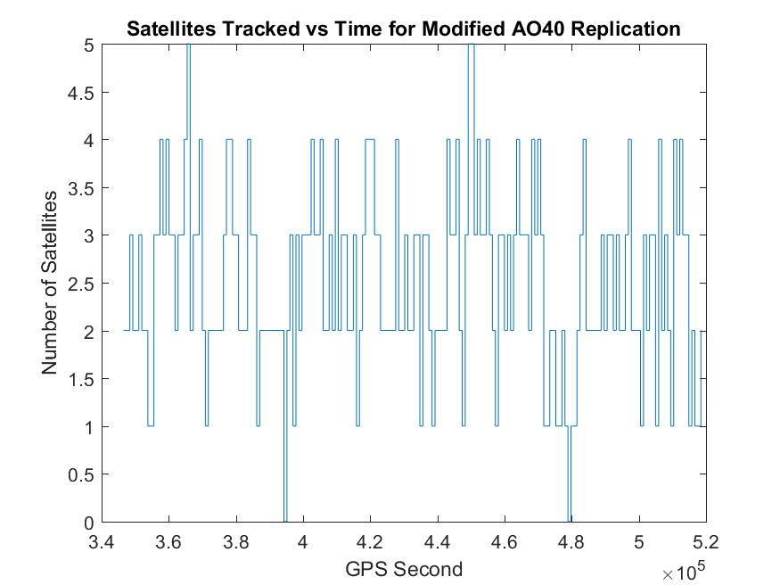
AO40 Replication
Notes:
2.5 sats on average, lowered threshold to 25 dbHz

Slide 19
AO40 Replication Parameters
Power Out | 30 [dBW]
Average Reception Gain | 5 [dB]
System Temperature | 190 [K]
Reception Losses | -4.5 [dB]
Tracking Threshold | 40 (25) [db-Hz]

Slide 20
Conclusions
How big should my antenna be?

Slide 21
Observability
Receiver Parameters
Satellite Geometry
Notes:
As seen in ao40, receiver parameters dominate the observability
The better the receiver, the more likely to be able to track gnss sats.

Slide 22
Possible Reach

Slide 23

Future Work
Implement more SVs, L2
Better RX model
$H′=\frac{∂C/N_{0}}{∂x}{\left.​\right|}_{x=\overline{x}}$

Slide 24
References
P. Misra and P. Enge. Global Positioning Systems. Lincoln, Massachusetts: Ganga-Jumana Press, revised second ed., 2012.
F. Bauer. GPS Space Service Volume. PNT Advisory Board Meeting, NASA. June 11, 2015.
T. Ebinuma and M. Unwin. GPS Receiver Demonstration on a Galileo Test Bed Satellite. The Journal of Navigation, The Royal Institute of Navigation. Pages 349-362, Vol. 60, No. 3, September 2007.
O. Montenbruck et al. GNSS Satellite Geometry and Attitude Models. Advances in Space Research. Pages 1015-1029, Vol 56, 2015.
J. Kronman. Experience Using GPS For Orbit Determination of a Geosynchronous Satellite. GPS 2000, Institute of Navigation. Pages 1622-1626, September 2000.
M. Moreau et al. Results from the GPS Flight Experiment on the High Earth Orbit AMSAT Oscar-40 Spacecraft. GPS 2002, Institute of Navigation. September 2002.
W. Marquis and D. Reigh. The GPS Block IIR and IIR-M Broadcast L-band Antenna Panel. Navigation, Institute of Navigation. Pages 329-347, Vol. 62, Issue 4, Winter 2015.

